Slide 1
Internet of
2
h
n
s
i
g
T
Introduction
Dr. Ramchand

Slide 2
What is the internet of things (IoT)?
The internet of things, or IoT, is a system of
Interrelated computing devices,
Mechanical and digital machines,
Objects,
Animals or
People that are provided with unique identifiers UIDs

Slide 3
The term ‘Internet of Things’ was coined by
Peter T. Lewis
in a
1985 speech
"The Internet of Things, or IoT, is the integration of
people,
Processes and
Technology
with connectable devices and sensors to
Enable remote monitoring,
Status,
Manipulation and
Evaluation of trends of such devices."

Slide 4
Smart Things
A smart Thing is a physical object augmented with one or more:
Sensors
Actuators
Computation
Communications (wired or wireless)
A sensor is a device that detects and responds to some type of input from the physical environment.
The input can be or any number of other environmental phenomena.
light,
heat,
motion,
moisture,
pressure
or any number of other environmental phenomena.

Slide 5
Sensors play a pivotal role in the internet of things (IoT).
They make it possible to create an ecosystem for collecting and processing data about a specific environment so it can be monitored, managed and controlled more easily and efficiently.
IoT sensors are used in homes, out in the field, in automobiles, on airplanes, in industrial settings and in other environments.
Sensors bridge the gap between the physical world and logical world

Slide 6
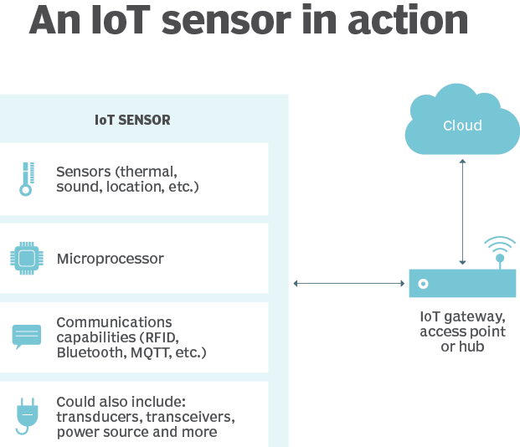
Thermal sensors are construction elements to measure temperature and engage functional dependence of a particular physical property of the sensory material on the temperature
A sound sensor is defined as a module that detects sound waves through its intensity and converting it to electrical signals
Microprocessor, any of a type of miniature electronic device that contains the arithmetic, logic, and control circuitry to perform the functions of a digital computer's central processing unit
Transducer: A device that converts variations in a physical quantity, such as pressure or brightness, into an electrical signal, or vice versa

Slide 7
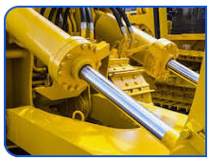
Actuators
An actuator is a part of a device or machine that helps it to achieve physical movements by converting energy, often electrical, air, or hydraulic, into mechanical force.
Actuators are present in almost every machine around us, from simple electronic access control systems, the vibrator on your mobile phone and household appliances to vehicles, industrial devices, and robots.
Common examples of actuators include electric motors, jackscrews, electric muscular stimulators in robots, etc.

Slide 8
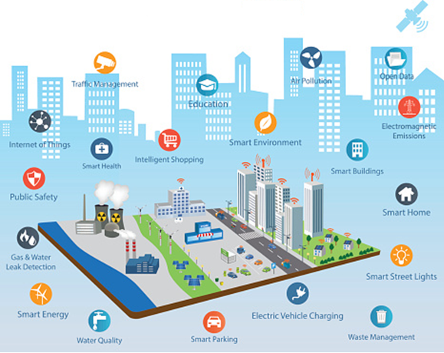
Smart Cities and homes
Help reduce waste and improve energy efficiency
Smart energy management
Air quality
Urban noise maps
Traffic congestion
Water quality
Smart parking
Autonomous cars

Slide 9
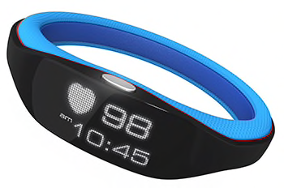
Wearables & the Quantified Self
Heart rate sensor watch
Calorie counting shoes
Lifelogging is about tracking personal activity (the quantified self), e.g. Fitbit
Lifestreaming is the stream of content we encounter in our lives, e.g. Google glass.
Notes:
http://lifestreamblog.com/lifelogging/
http://www.technori.com/2013/04/4281-the-beginners-guide-to-quantified-self-plus-a-list-of-the-best-personal-data-tools-out-there/

Slide 10
The Web of Things
The Web is the world's largest vendor-neutral distributed application platform.
“The Web of things seeks to counter fragmentation of the IoT through metadata and APIs, building upon W3C’s framework for linked data.”
The web provides a unifying framework for semantic interoperability.
Notes:
http://www.w3.org/2016/09/IoTW/wot-intro.pdf

Slide 11
Location of Things
The ability of “things” to sense and communicate their geographic position.
Global Positioning System (GPS)
Indoor Positioning System (IPS)
An indoor positioning system (IPS) is a network of devices used to locate people or objects
Location Based Services. e.g. geo-fencing
A software service for mobile device applications that requires knowledge about where the mobile device is geographically located
Notes:
http://internetofthingsagenda.techtarget.com/blog/IoT-Agenda/Location-of-things-Why-location-matters-in-IoT
http://www.psfk.com/2016/01/ces-2016-iot-internet-of-things-pixie-location-of-things.html

Slide 12

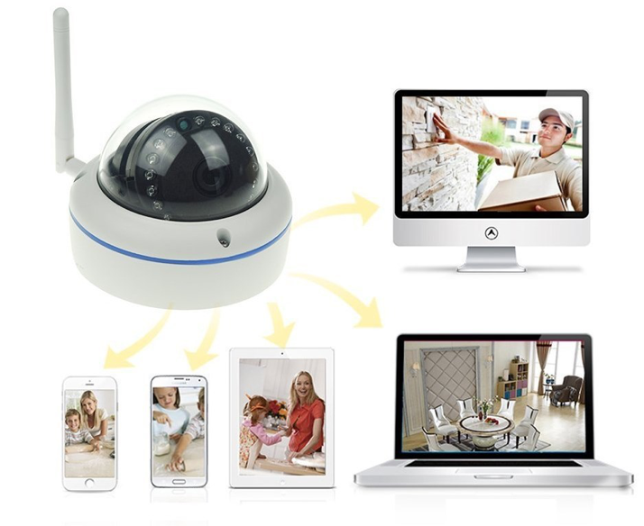
IoT & Security
ENCRYPT ALL THE THINGS
“Door locks and padlocks … were found to be vulnerable to password sniffing and replay attacks, where a captured command can be replayed later to open the locks.”
The IoT Security Foundation (IoTSF) was launched on 23 September 2015.
Notes:
Encrypt all the things

Slide 13
Chain of Things?
Blockchain is the technology behind Bitcoin, “The network timestamps transactions by hashing them into an ongoing chain of hash-based proof-of-work” Satoshi Nakamoto
As a secure distributed ledger, shipping chains (the bill of lading) can be verified
smart peer-to-peer contracts for the sharing economy - Proving identity.
The cryptographic algorithms used by blockchain’s ensure data privacy.
Notes:
http://www.chainofthings.com

Slide 14







Phil
Jack
Ted
Sam
Jack paid the total bill amount

Slide 15
Phil is transferring the bit coin’s to Jack
Phil
Phil -> 2BT C Jack
Jack
Transaction details between them is permanently inscribed in this block

Slide 16

All are paying to Jack
11
7
9
1
Phil
Jack
1
Ted
1
Sam
Phil -> 2BT C Jack
Ted -> 2BT C Jack
Sam -> 2BT C Jack
Jack: 7 Phil: 1
Jack: 9 Phil: 1
Jack: 11 Phil: 1
Sam: 3 Ted: 3
Ted: 1 Sam: 3
Sam: 1 Ted: 1

Slide 17
Ted and Sam will block the transaction
and flag the transaction as invalid
11
7
9
1
Phil
Jack
1
Ted
1
Sam
Phil -> 2BT C Jack
Ted -> 2BT C Jack
Sam -> 2BT C Jack
Jack: 7 Phil: 1
Jack: 9 Phil: 1
Jack: 11 Phil: 1
Sam: 3 Ted: 3
Ted: 1 Sam: 3
Sam: 1 Ted: 1

Slide 18
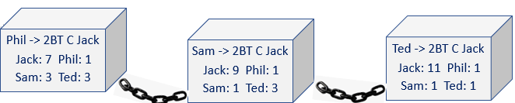
Phil
Hacker will not be able to ALTER the DATA in the blockchain
because
Each user will have a copy of ledger
Ted
The data within the blocks are encrypted by complex algorithms
Sam
Jack

Slide 19
Phil
Hacker will not be able to ALTER the DATA in the blockchain
because
Each user will have a copy of ledger
Ted
The data within the blocks are encrypted by complex algorithms
Sam
Collection of records
Linked with each other
Strongly resistant to alteration
Jack
Protected using cryptography

Slide 20
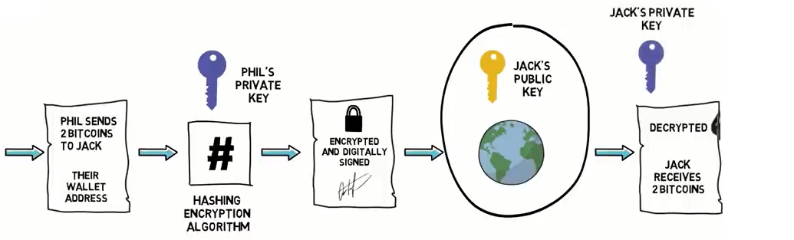

Slide 21



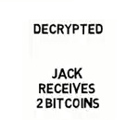






Phil’s Private key
Jack’s Public key
Jack’s Private key

Slide 22
What is the internet of things (IoT)? (Cont…)
The ability to transfer data over a network without requiring
human-to-human
or
human-to-computer interaction.
A thing in the internet of things can be a person with
a heart monitor implant,
a farm animal with a biochip transponder,
an automobile that has built-in sensors to alert the driver when tire pressure is low
or
any other natural
or
man-made object that can be assigned an Internet Protocol (IP) address and is able to transfer data over a network.

Slide 23
Increasingly, organizations in a variety of industries are using IoT to operate
more efficiently,
better understand customers to deliver enhanced customer service,
improve decision-making and
increase the value of the business.

Slide 24
With IoT.
Collect data
Collate data
analyze data, take action
IoT (e.g. Sensor)
User Interface (smartphone, human machine)
IoT Hub
IoT Device
(e.g. antenna)
or
Analytics of business applications (e.g. customer relationship management, ERP)
IoT Device
(e.g. microcontroller)
IoT Gateway
Back end systems

Slide 25
How does IoT work?
An IoT ecosystem consists of web-enabled smart devices that use
embedded systems, such as
processors,
sensors and
communication hardware, to collect, send and act on data they acquire from their environments.
IoT devices share the sensor data they collect by connecting to an IoT gateway or other edge device where data is either sent to the cloud to be analyzed or analyzed locally.
Sometimes, these devices communicate with other related devices and act on the information they get from one another.

Slide 26
Why is IoT important?
The internet of things helps people live and work smarter, as well as gain complete control over their lives.
In addition to offering smart devices to automate homes, IoT is essential to business.
IoT provides businesses with a real-time look into how their systems really work, delivering insights into everything from the performance of machines to supply chain and logistics operations.
IoT enables companies to automate processes and reduce labor costs.
It also cuts down on waste and improves service delivery, making it less expensive to manufacture and deliver goods, as well as offering transparency into customer transactions.
As such, IoT is one of the most important technologies of everyday life, and it will continue to pick up steam as more businesses realize the potential of connected devices to keep them competitive.

Slide 27
Benefits of IoT
Some benefits are industry-specific, and some are applicable across multiple industries.
Some of the common benefits of IoT enable businesses to:
Monitor their overall business processes;
Improve the customer experience;
Save time and money;
Enhance employee productivity;
Integrate and adapt business models;
Make better business decisions; and
Generate more revenue.

Slide 28
Pros of IoT
Ability to access information from anywhere at any time on any device
Improved communication between connected electronic devices
Transferring data packets over a connected network saving time and money
Automating tasks helping to improve the quality of a business's services and reducing the need for human intervention

Slide 29
Cons of IoT
As the number of connected devices increases and more information is shared between devices, the potential that a hacker could steal confidential information also increases
Enterprises may eventually have to deal with massive numbers -- maybe even millions -- of IoT devices, and collecting and managing the data from all those devices will be challenging.
If there's a bug in the system, it's likely that every connected device will become corrupted
Since there's no international standard of compatibility for IoT, it's difficult for devices from different manufacturers to communicate with each other

Slide 30
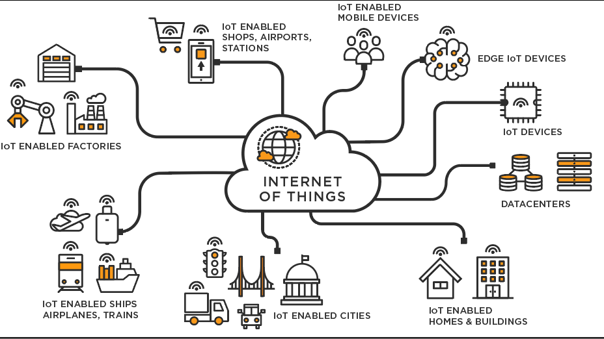

Slide 31
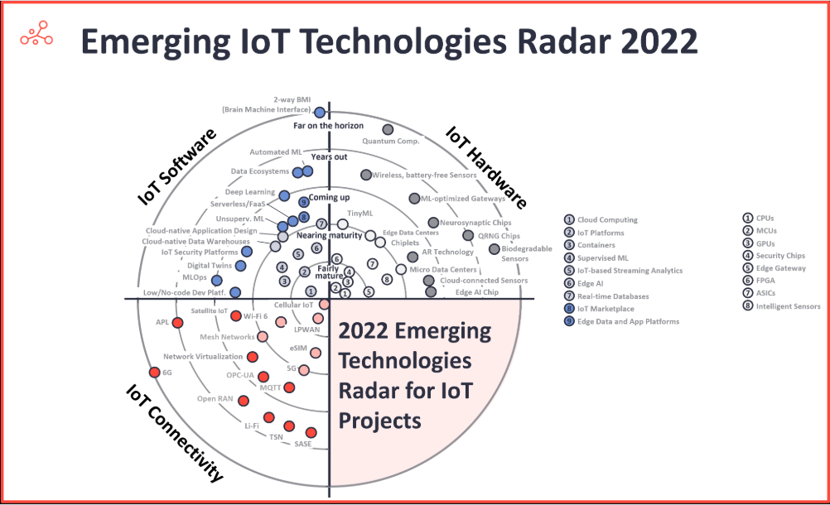

Slide 32
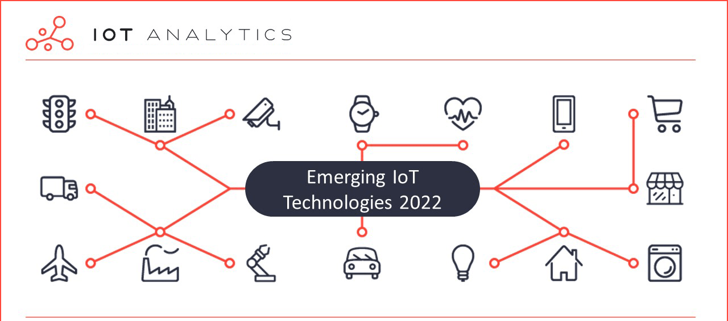

Slide 33
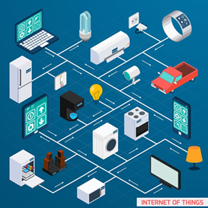
“The infrastructure of the information society.”
The Global Standards Initiative on Internet of Things (IoT-GSI)
"Anything that can be connected, will be connected.” Forbes

Slide 34
Thank you

